Slide 1

Economics Course Code:CSER-1209
Md. Rabiul Karim
Assistant Professor
Department of Economics
Jagannath University, Dhaka
Email: rabiulkarimjnu@gmail.com

Slide 2
Definition of Market
Place where there are many buyers and sellers .
Actively engaged in buying and selling acts.
Thus, It does not mean a particular place but the entire area where buyers and sellers of a commodity are in close contact and they have one price of same commodity.
A market does not mean a particular place but the whole region where sellers and buyers of a product are spread.

Slide 3
Market structure
Market structure consists of four main market characteristics:
The number of sellers and buyers,
The nature of the product,
The ability of individual firms to influence the market price,
The ease of entry into or exit from the market.

Slide 4
Types of market structure
Perfect Competition
Monopoly Competition
Monopolistic Competition
Oligopoly Competition

Slide 5
Perfect competition
It is such a market structure where there are large numbers of sellers and buyers.
Homogeneous product .
The price of the product is determined by the industry .
One price prevails in the market and all the firms sell the product at the prevailing price .

Slide 6
Characteristics
Large number of buyers and sellers
Homogeneous product
No barriers to entry
Perfect knowledge of the market
Perfect mobility of factors of production

Slide 7
Monopoly
It is a market structure in which there is only a single seller of the product .
One firm has full control over the supply of the product .
Example : WASA, Titas Gas Distribution etc.

Slide 8
Characteristics
Sole supplier of the product
Large number of buyers
No close substitutes
One firm industry
Absence of entry
Monopolist is price maker

Slide 9
Monopolistic Competition
Refers to the market organization in which there are many firms selling closely related but not identical commodities.
Example: Soap (Lux, Lifebuoy, Sandolina)

Slide 10
Characteristics
Many firms
Closely related but not identical product
Sellers have some degree of control over the prices

Slide 11
Oligopoly
It is a market structure in which there are few sellers of a product selling identical or differentiated products .
If they are selling identical products, it’s a case of Pure Oligopoly.
Such as: Mobile phone company

Slide 12
Characteristics
Relatively small number of sellers
Interdependence of the firms
Price rigidity and price war
Difficulty in entry and exit

Slide 13
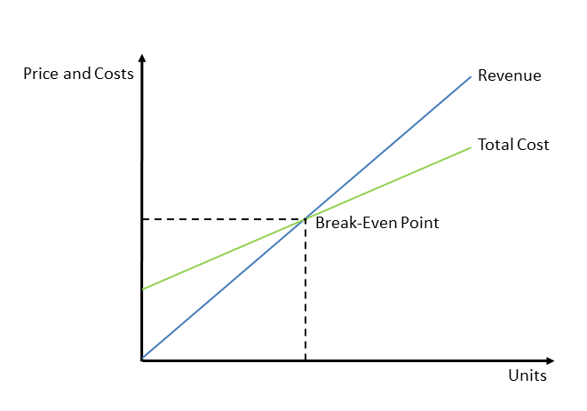
Short-Run Equilibrium of the firm: Total Approach
Total Profit : Total Revenue (TR) - Total Cost (TC)
Total Revenue (TR)= P . Q ; P= Price, Q= Quantity
Price (P) will be remain same in perfect competition market
Brake Event point: Total Revenue is equal to Total Cost (TR=TC)

Slide 14
Short-Run Equilibrium of the firm: Marginal Approach
Marginal Revenue (MR) = is the change in TR for one-unit change in the quantity sold.
Marginal Cost (MC) = is the change in TC for one-unit change in the quantity sold.
As price (P) will be remain same in perfect competition market, so MR = P.
Condition of Market Equilibrium
MR = MC
Slope of MC is greater than slope of MR

Slide 15
Short-Run Equilibrium of the firm
A firm in Short Run Equilibrium may face one of these situations
Super Normal Profits
Normal Profits
Minimum Losses

Slide 16
Super-Normal Profits : AR>SAC
A Firm in Equilibrium earns super normal profit, when average revenue is more than its short-run average cost (SAC)
Firm equilibrium point=E, where MR = MC
Equilibrium output=EM
Total Cost: OBAM
Total Revenue: OPEM
Super Normal Profit:
OPEM - OBAM
=BPEA
=Shaded area
Since AR>SAC
Firm is earning EA super
normal profit per unit of
output.
Super Normal Profit
SMC
SAC
P
E
Cost / Revenue
B
A
AR=MR
O
M
Output

Slide 17
Normal Profits : AR=SAC
A Firm in Equilibrium earns normal profit, when average revenue is equal to its short-run average cost (SAC)
Firm equilibrium point=E, where MR = MC
Equilibrium output=EM
Total Cost= OPEM
Total Profit= OPEM
Normal Profit= OPEM – OPEM
= 0
At this output AR and SAC
both are equal to EM and
Firm is earning normal
profit per unit of output
SAC
SMC
P
E
Cost / Revenue
AR=MR
O
Output
M

Slide 18
Minimum Loss : AR<SAC
A Firm will be in equilibrium at that level of output where it gets the minimum losses when SAC is more than AR.
Total Revenue: OPEM
Total Cost : OBAM
Minimum Loss: OPEM - OBAM
= - PBAE
At equilibrium AR=EM and
SAC=AM and also from
graph AR<SAC
Even if Firm discontinues
the production, it will have
to bear the loss of fixed
cost which is minimum
possible loss of a Firm.
Loss
SAC
SMC
B
A
Cost / Revenue
P
E
AR=MR
O
Output
M

Slide 19
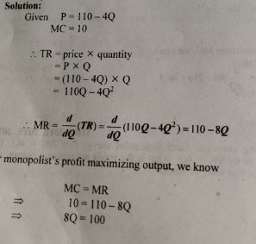

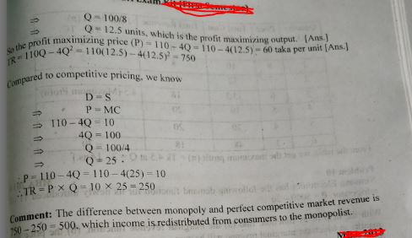

Slide 20

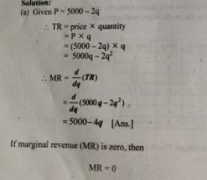


Slide 21
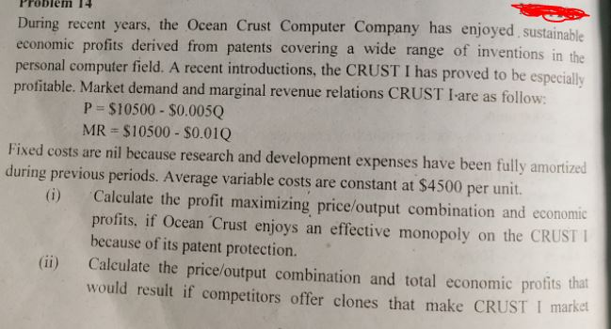
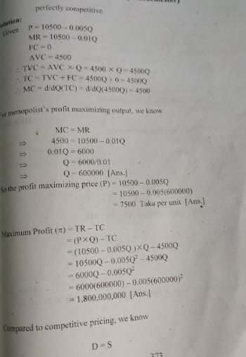
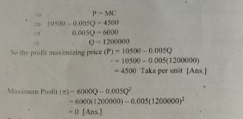

Slide 22
Thanks

